Slide 1
Power system fault detection and classification.
CAPSTONE PROJECT
Presented By:
Shakti Swaroop Nayak – Government College of Engineering Keonjhar – Electrical Engineering
GitHub Link: https://github.com/shaktissn

Slide 2
OUTLINE
Problem Statement (Should not include solution)
Proposed System/Solution
System Development Approach (Technology Used)
Algorithm & Deployment
Result (Output Image)
Conclusion
Future Scope
References

Slide 3
Problem Statement
Power distribution systems are susceptible to various faults such as line-to-ground, line-to-line, and three-phase faults, which can lead to equipment damage and outages. Traditional protection systems rely on fixed settings and may lack the flexibility to accurately detect and classify these faults under dynamic conditions. Hence, there is a need for a data-driven ML model that leverages voltage and current phasors for accurate fault classification in real-time.

Slide 4
Proposed Solution
We propose a machine learning-based system to detect and classify power system faults using real-time electrical parameters. The model is trained on labelled voltage and current phasor data from the Kaggle dataset to distinguish between different fault types and normal conditions.
Components:
- Dataset: Kaggle power system faults dataset
- Preprocessing: Normalization & feature selection
- Algorithm: Random Forest / SVM / LSTM
- Deployment: IBM Cloud Lite with Flask-based API
- Evaluation Metrics: Accuracy, Precision, Recall, F1-score

Slide 5
System Approach
System requirements:
Python environment
IBM Cloud Lite account (Watson Studio, Cloud Object Storage)
Libraries and services:
IBM Watson Studio for notebook development and model management
IBM Cloud Functions for serverless inference API
IBM Cloud Object Storage for training data and model artifacts

Slide 6
Algorithm & Deployment
Algorithm:
Random Forest Classifier / LSTM for time series
Input Features:
Voltage and Current phasors
Training:
Data split into training/testing, normalization, model training
Deployment:
Model hosted on IBM Cloud using Flask, accessible via REST API
Real-time data can be streamed for live fault classification

Slide 7
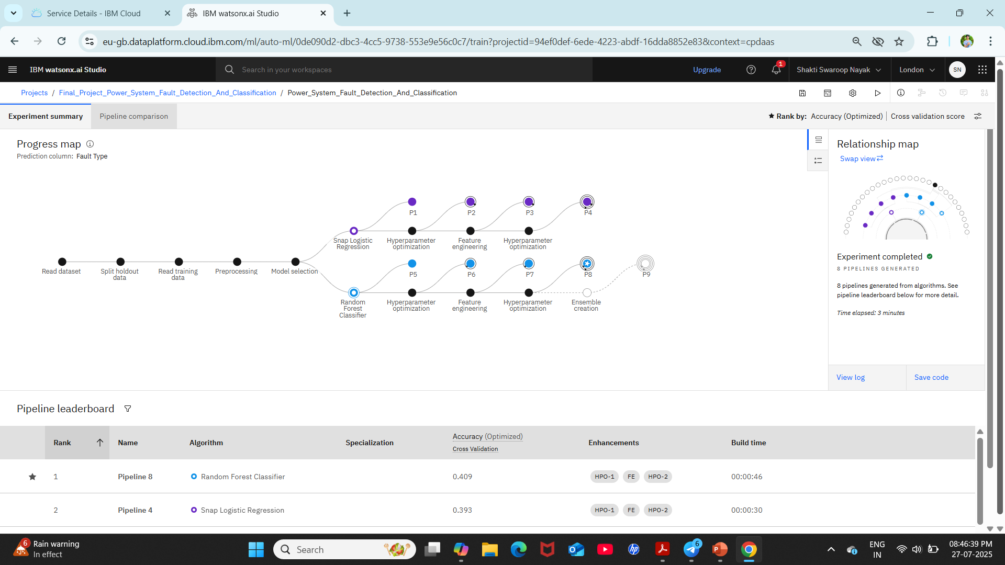
Result

Slide 8
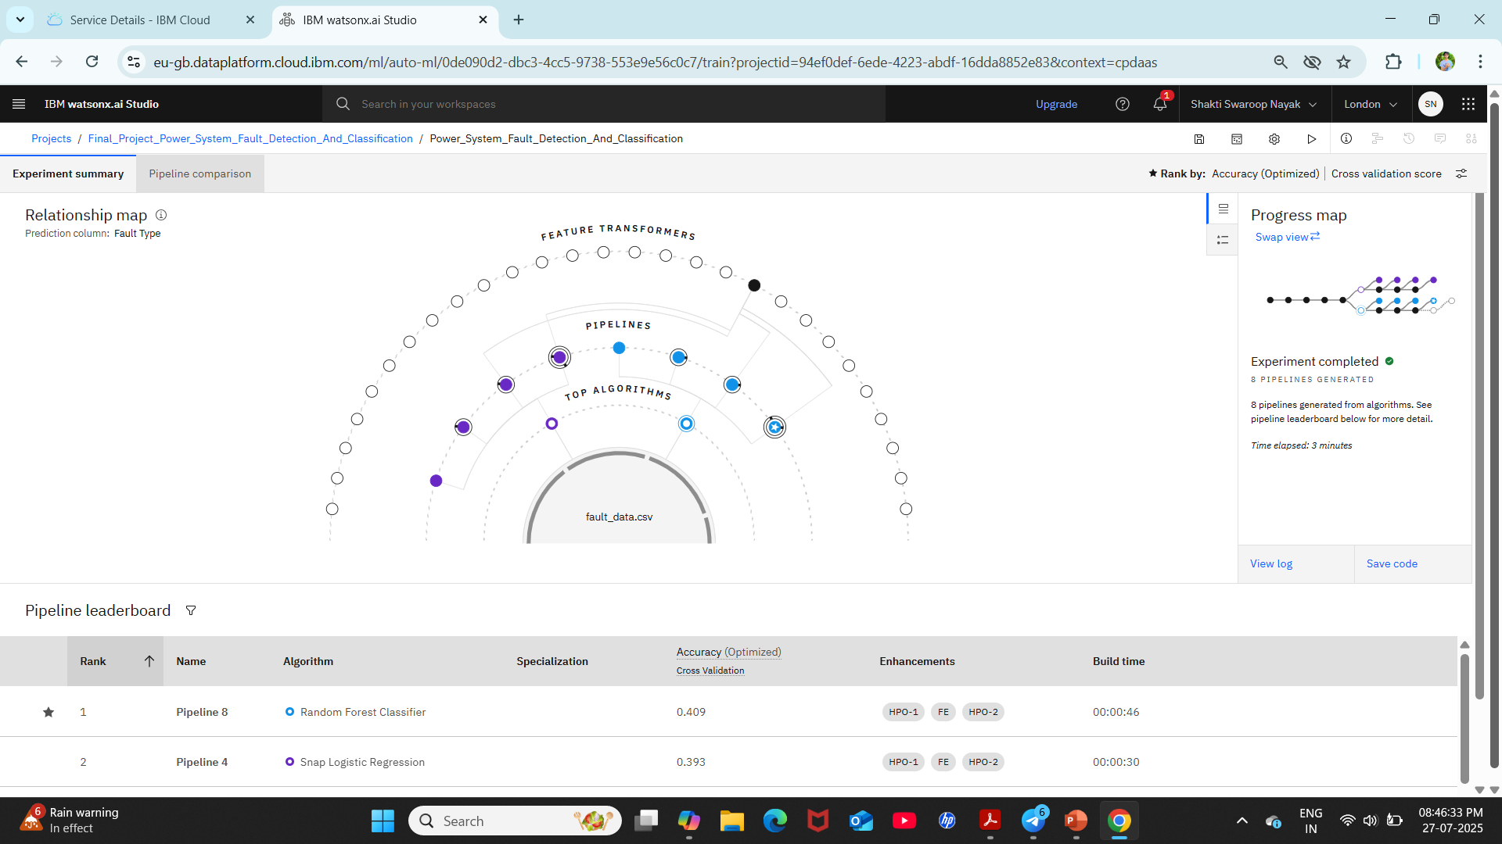
Result

Slide 9
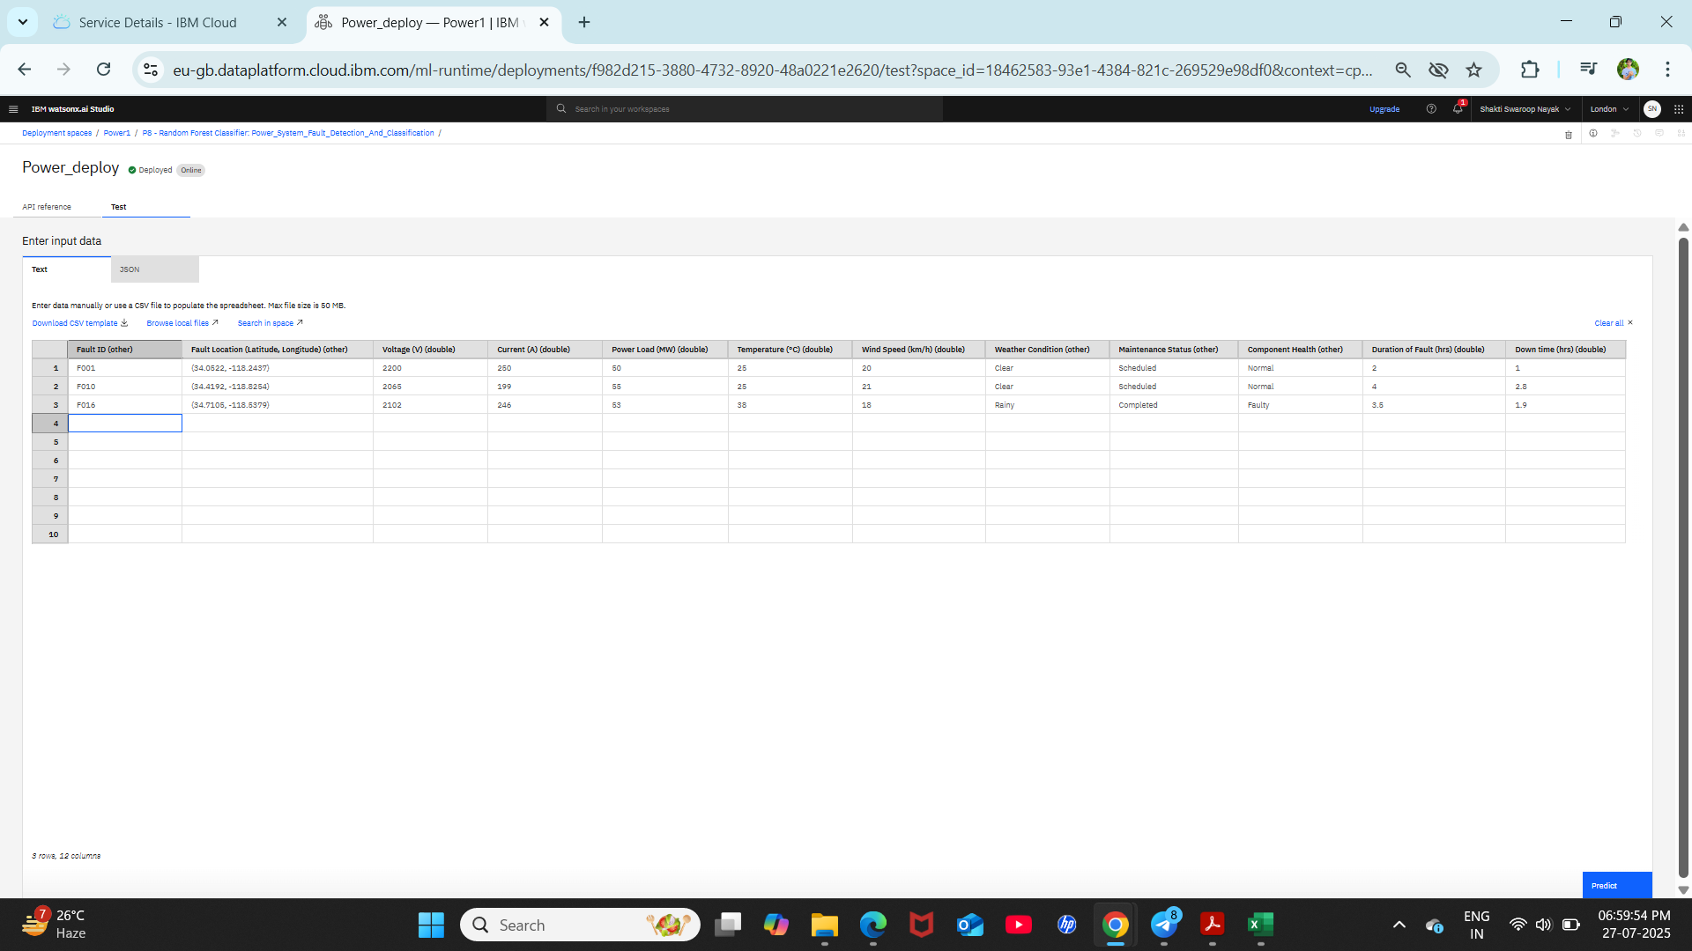
Result

Slide 10
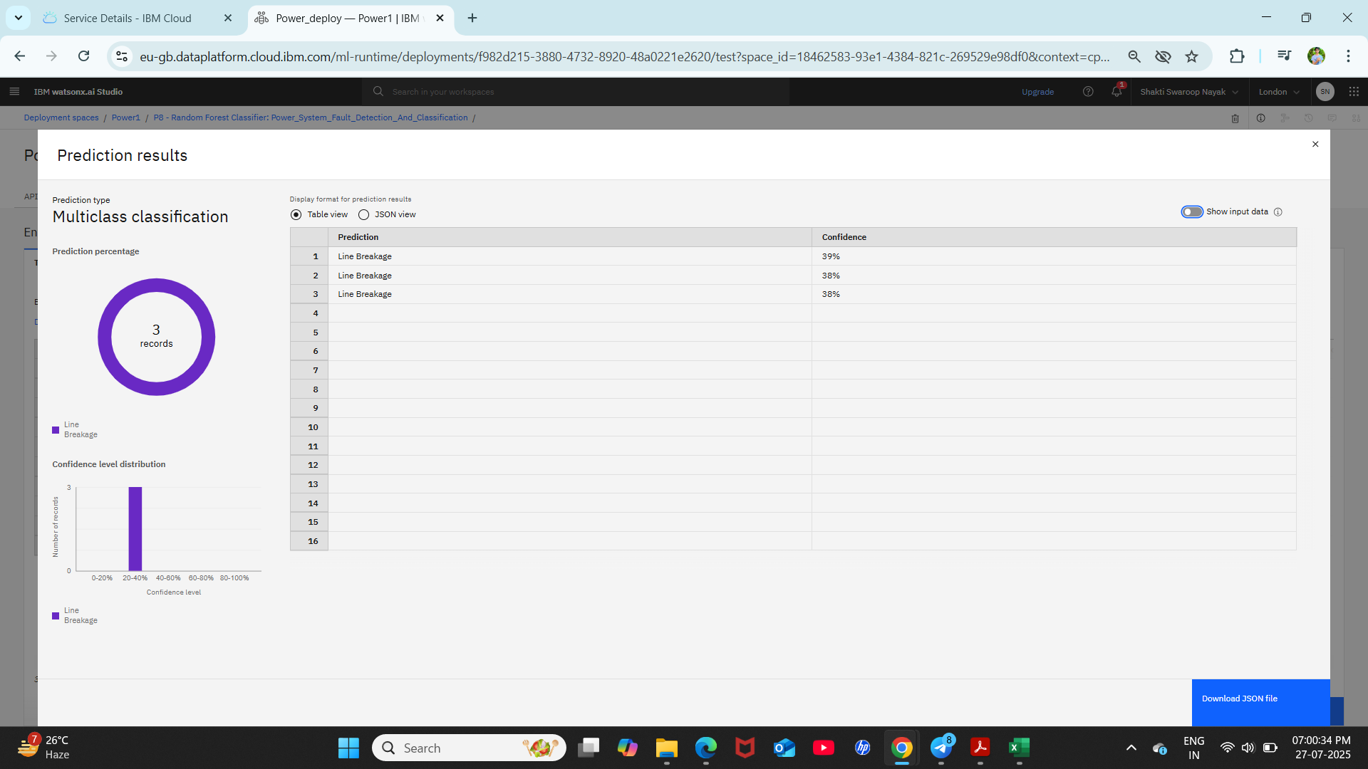
Result

Slide 11
Conclusion
The ML-based fault detection model successfully classifies various power system faults with high accuracy. Deployment on IBM Cloud Lite ensures scalable and accessible real-time monitoring. The system demonstrates faster and more reliable fault detection than conventional methods.

Slide 12
Future scope
- Integrate with SCADA systems for real-time operation
- Expand fault classification to include more fault types
- Use deep learning models like CNNs for waveform-based classification
- Improve latency and accuracy using edge AI solutions

Slide 13
References
1. Kaggle Dataset – https://www.kaggle.com/datasets/ziya07/power-system-faults-dataset
2. IEEE papers on power system fault detection
3. IBM Cloud documentation and tutorials
4. scikit-learn, pandas, numpy documentation

Slide 14
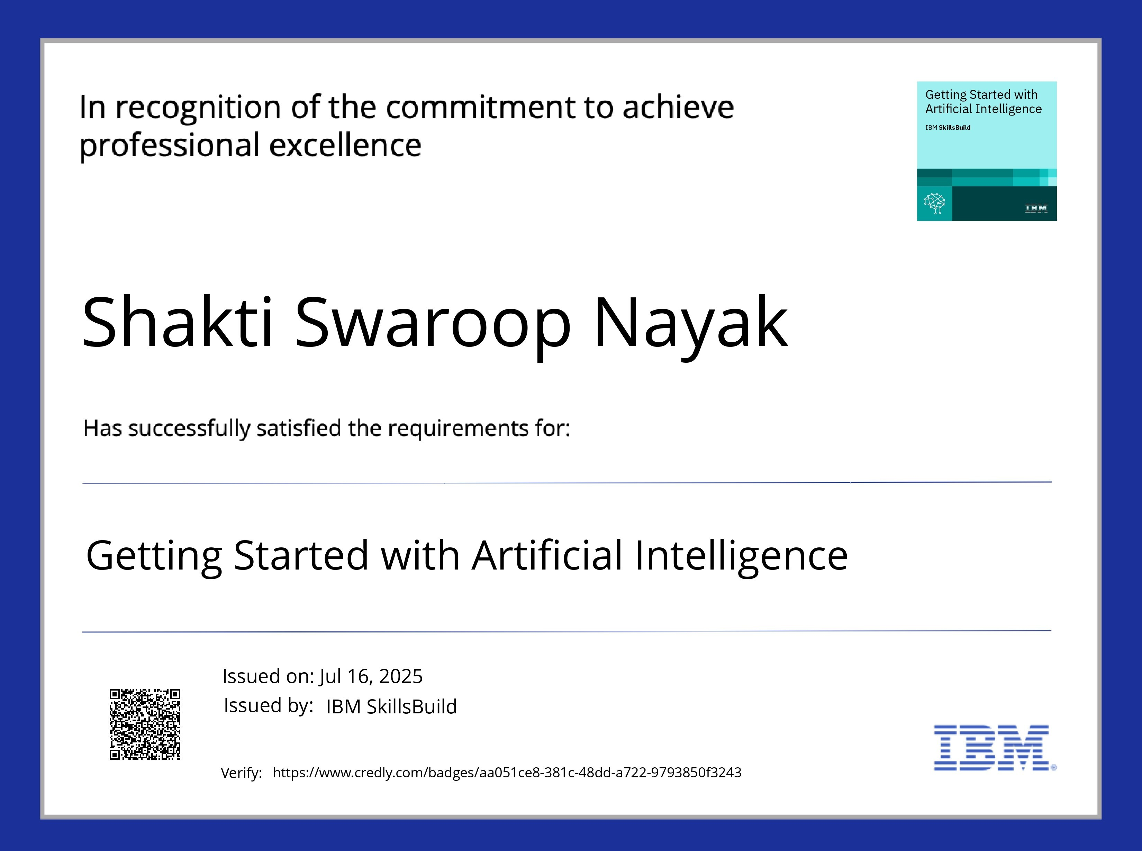
IBM Certifications
Screenshot/ credly certificate( getting started with AI)

Slide 15
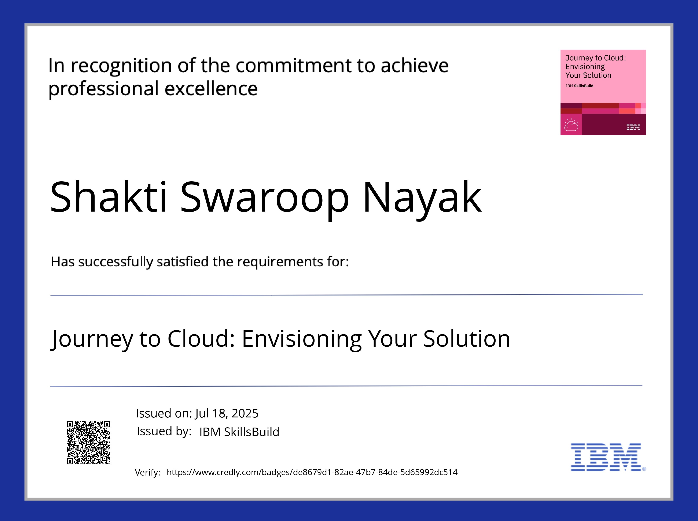
IBM Certifications
Screenshot/ credly certificate( Journey to Cloud)

Slide 16
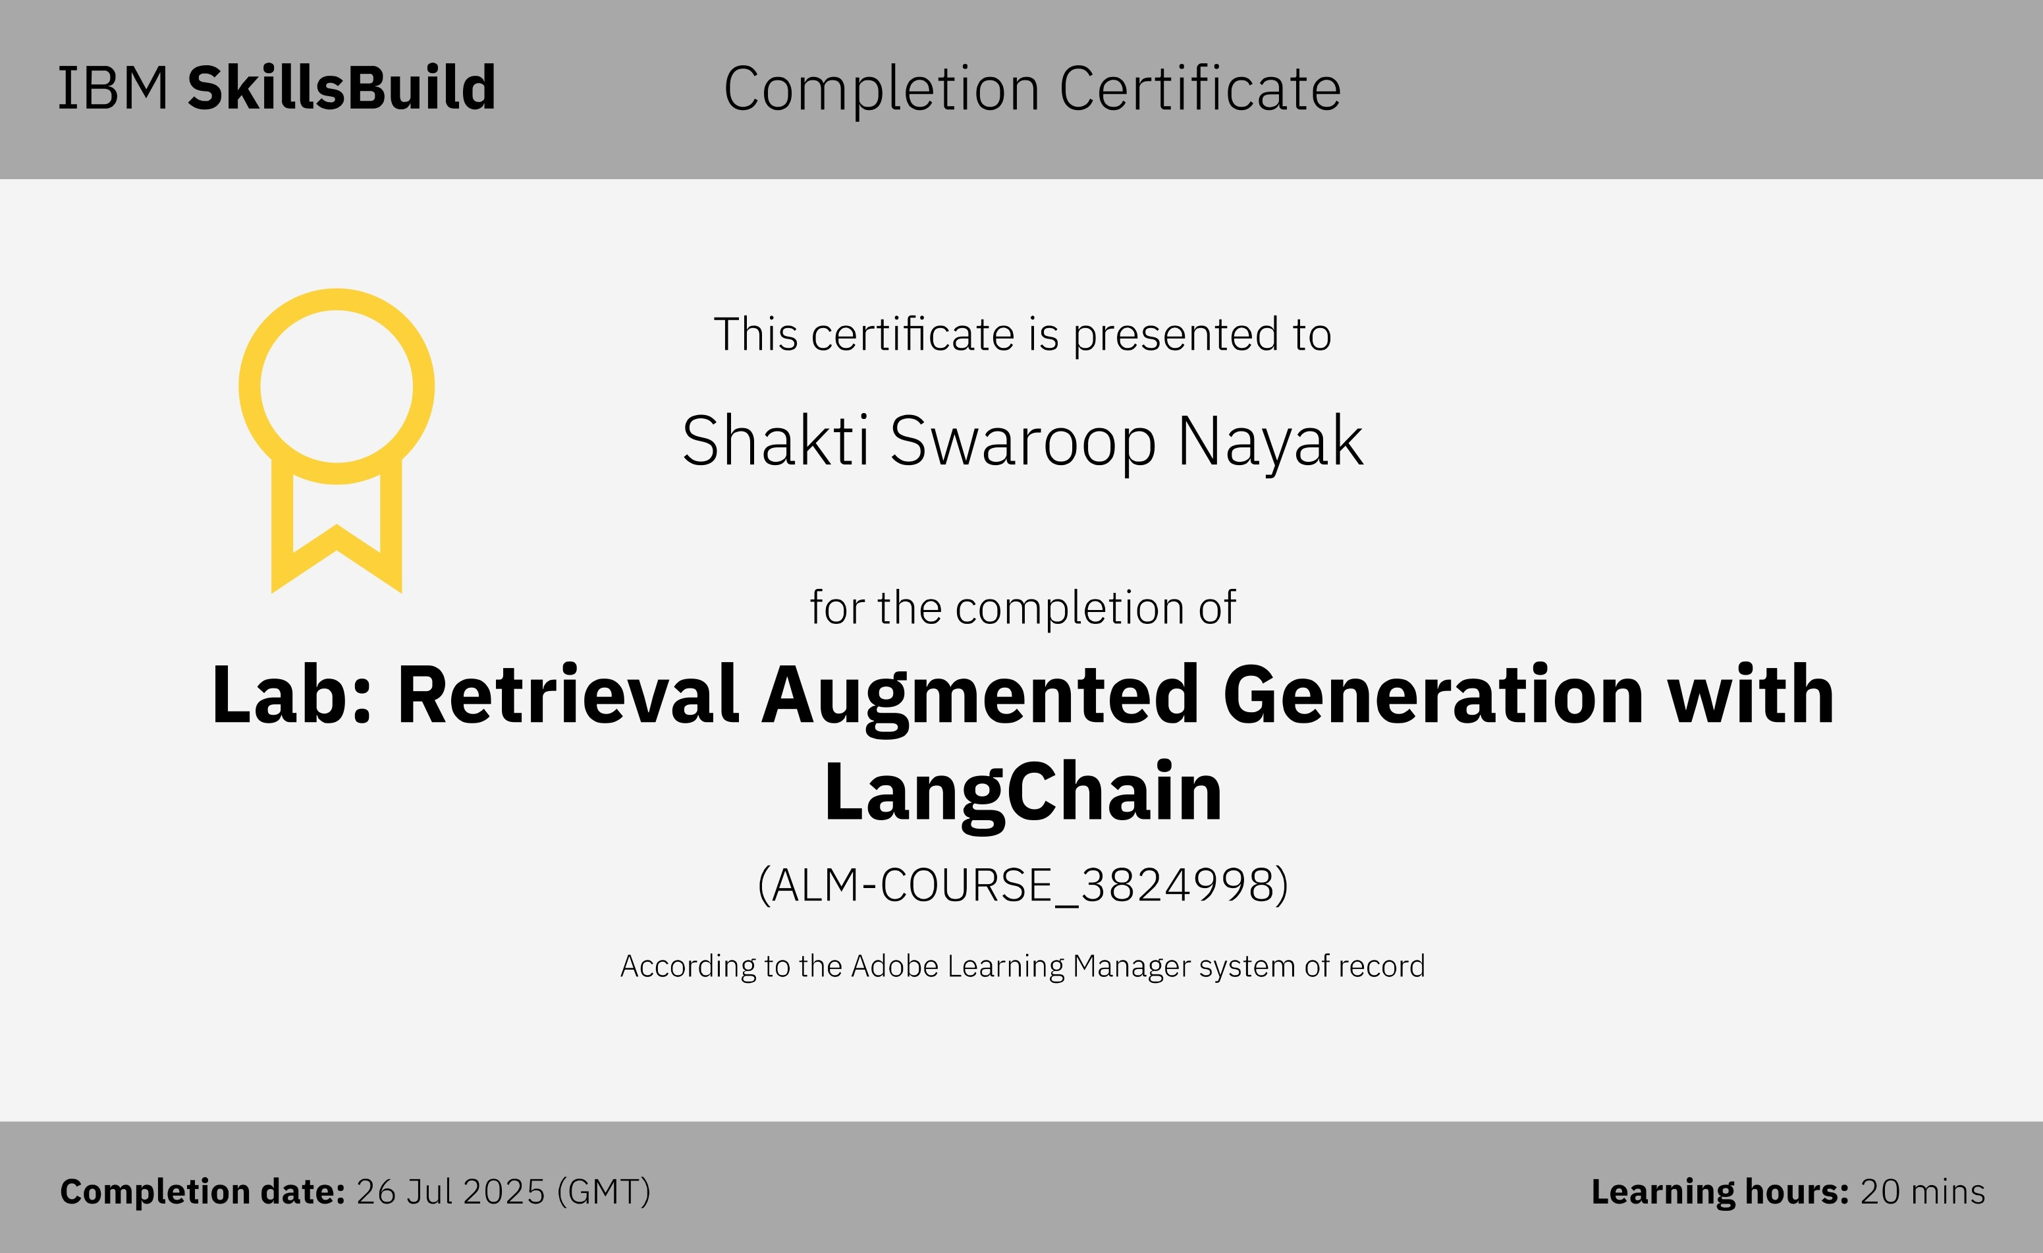
IBM Certifications
Screenshot/ credly certificate( RAG Lab)

Slide 17
THANK YOU

